Slide 1

File System vs DBMS
Infoway Technologies, 3rd Floor Commerce Centre, Rambaug Colony, Paud Road Pune 411038

Slide 2
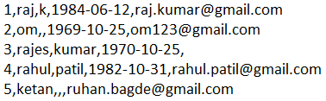
File System
A flat file database is a database that stores data in a plain text file. Each line of the text file holds one record, with fields separated by delimiters, such as commas or tabs. While it uses a simple structure, a flat file database cannot contain multiple tables like a relational database can have.
Infoway Technologies, 3rd Floor Commerce Centre, Rambaug Colony, Paud Road Pune 411038

Slide 3
Advantages of Flat Files
The biggest advantage of file-based storage is that anyone can understand the system.
Advantage of File-oriented system
Backup: It is possible to take faster and automatic back-up of database stored in files of computer-based systems.
Data retrieval: Computer-based systems provide enhanced data retrieval techniques to retrieve data stored in files in easy and efficient way.
Editing: It is easy to edit any information stored in computers in form of files.
Remote access: In computer-based systems, it is possible to access data remotely.
Sharing: Data stored in files of computer-based systems ca be shared among multiple users at a same time.
Infoway Technologies, 3rd Floor Commerce Centre, Rambaug Colony, Paud Road Pune 411038

Slide 4
Disadvantage of Flat Files
The biggest disadvantage of file-based storage is as follows.
Disadvantage of File-oriented system
Data redundancy: It is possible that the same information may be duplicated in different files. This leads to data redundancy results in memory wastage.
Data inconsistency: Because of data redundancy, it is possible that data may not be in consistent state.
Limited data sharing: Data are scattered in various files and also different files may have different formats and these files may be stored in different folders so, due to this it is difficult to share data among different applications.
Data security: Data should be secured from unauthorized access, for example a student in a college should not be able to see the payroll details of the teachers, such kind of security constraints are difficult to apply in file processing systems.
Infoway Technologies, 3rd Floor Commerce Centre, Rambaug Colony, Paud Road Pune 411038

Slide 5
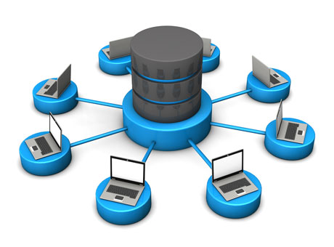
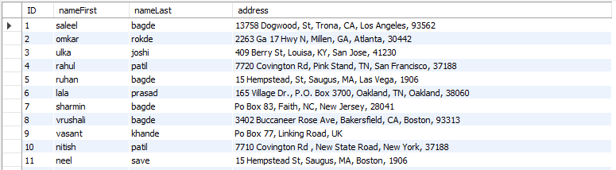
DBMS
database: Is the collection of related data which is organized, which is also called as structured data.
management system: is a software package designed to manipulate, retrieve and manage data in a database.
Infoway Technologies, 3rd Floor Commerce Centre, Rambaug Colony, Paud Road Pune 411038

Slide 6
Advantages of DBMS
Advantage of DBMS
Improved data sharing: The DBMS helps create an environment in which end users have better access to more and better-managed data.
Improved data security: The more users access the data, the greater the risks of data security breaches. DBMS provides a framework for better enforcement of data privacy and security policies.
Minimized data inconsistency: Data inconsistency exists when different versions of the same data appear in different places.
Minimized data redundancy : DBMS controls the data redundancy of all data into a single database file.
Infoway Technologies, 3rd Floor Commerce Centre, Rambaug Colony, Paud Road Pune 411038

Slide 7
Disadvantages of DBMS
Disadvantage of DBMS
Cost of Hardware and Software of a DBMS is quite high
Most database management systems are often complex systems, so the training for users to use the DBMS is required.
All data is integrated into a single database which can be damaged because of electric failure or database is corrupted on the storage device.
Infoway Technologies, 3rd Floor Commerce Centre, Rambaug Colony, Paud Road Pune 411038

Slide 8
Difference between File System vs DBMS
File Management System | Database Management System
File System is a general, easy-to-use system to store general files which require less security and constraints. | Database management system is used when security constraints are high.
Data Redundancy is more in file management system. | Data Redundancy is less in database management system.
Data Inconsistency is more in file system. | Data Inconsistency is less in database management system.
Centralization is hard to get when it comes to File Management System. | Centralization is achieved in Database Management System.
User locates the physical address of the files to access data in File Management System. | In Database Management System, user is unaware of physical address where data is stored.
Security is low in File Management System. | Security is high in Database Management System.
File Management System stores unstructured data. | Database Management System stores structured data.

